Slide 1


Literature survey – sarcasm detection July 2022
- Sanjeev KUmar

Slide 2
Introduction
Sarcasm is a subtle form of language in which people express the opposite of what is implied.
Sarcasm is often expressed through several verbal and non-verbal cues, e.g., a change of tone, overemphasis in a word, a drawn-out syllable, or a straight looking face.
Application in review summarization, dialog systems and sentiment analysis.
Some Examples

Slide 3
Introduction
I absolutely love to be ignored!
2. Yay!!! The best thing to wake up to is my neighbor’s drilling.
3. Perfect movie for people who can’t fall asleep.

Slide 4
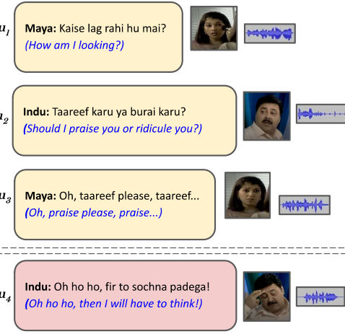
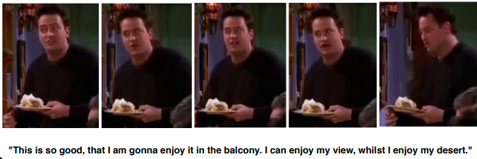
Introduction

Slide 5

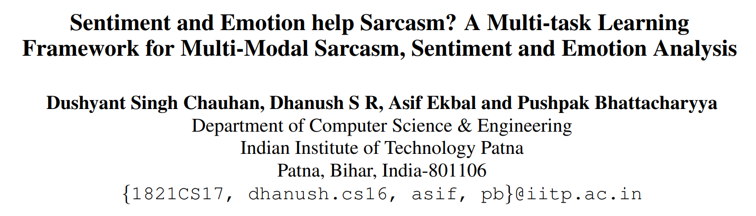
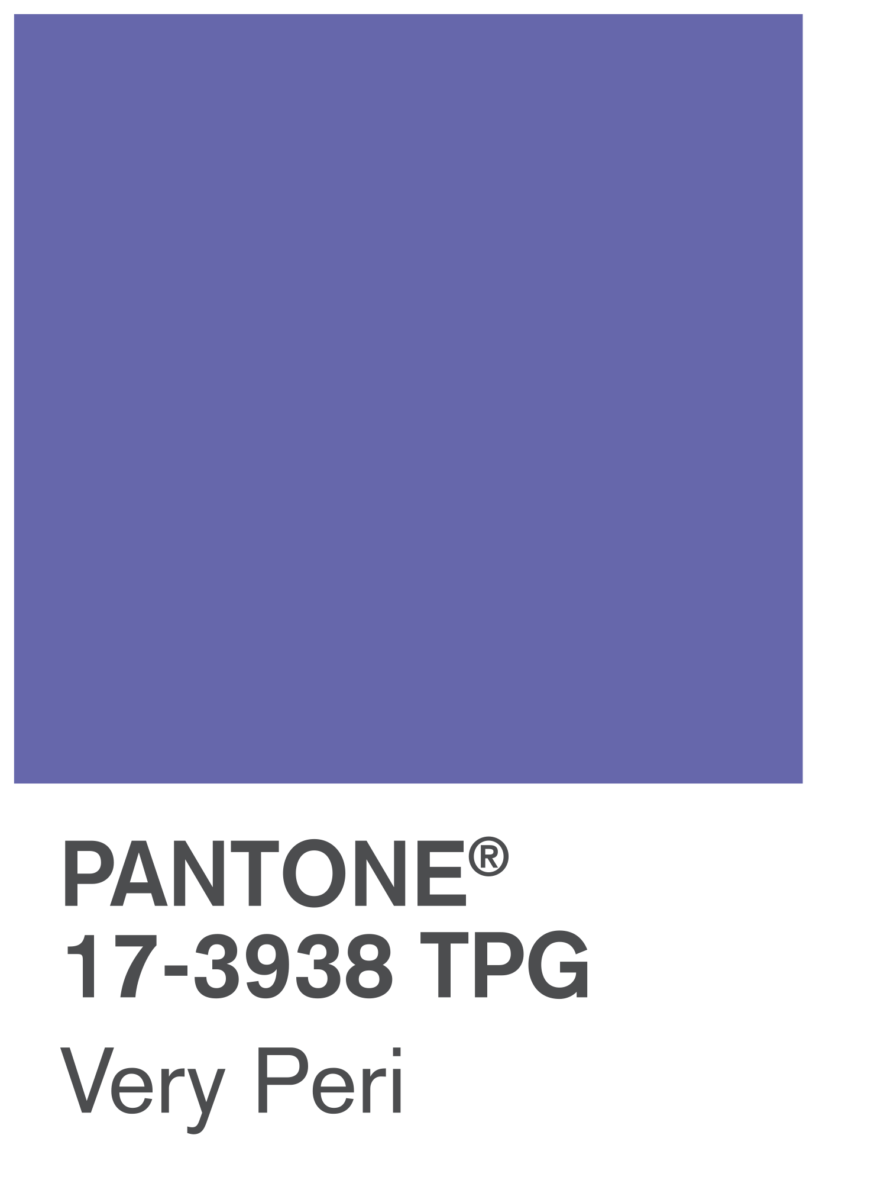
VERY PERI
Introducing the Pantone Color of the Year 2022. PANTONE 17-3938 Very Peri is a dynamic hue that blends the faithfulness and constancy of blue with the energy and excitement of red.
The four color palettes in this template feature Very Peri to help you express your ideas and convey the right mood. Read on to learn how to use these colors in any presentation.

Slide 6
Problem Statement
we hypothesize that sarcasm is closely related to sentiment and emotion, and thereby propose a multi-task deep learning framework to solve all these three problems simultaneously in a multimodal conversational scenario.
we propose two attention mechanisms, viz. Inter-segment Inter-modal Attention (IeAttention) and Intra-segment Inter-modal Attention (Ia-Attention).
the proposed multi-task framework yields better performance for the primary task, i.e., sarcasm detection, with the help of two secondary tasks, emotion and sentiment analysis

Slide 7
Motivation
we hypothesize that sarcasm is closely related to sentiment and emotion
For sarcasm classification, we observe that multitask learning with sentiment and emotion together shows better performance for both the setups (i.e. speaker dependent and speaker independent) over the single-task learning framework.
main motivation of Ie-Attention is to learn the relationship between the different segments of the sentence across the modalities.
Ia-Attention focuses within the same segment of the sentence across the modalities.

Slide 8
Methodology
multi-modal sarcasm detection in a multi-task framework.
Manually annotating the multi-modal MUStARD sarcasm dataset
Each sample in the dataset consists of an utterance (u) accompanied by its context (c) and label (sarcasm, implicit sentiment, explicit sentiment, implicit emotion, and explicit emotion).
The proposed model takes multi-modal inputs i.e., text (T), acoustic (A), and visual (V)

Slide 9
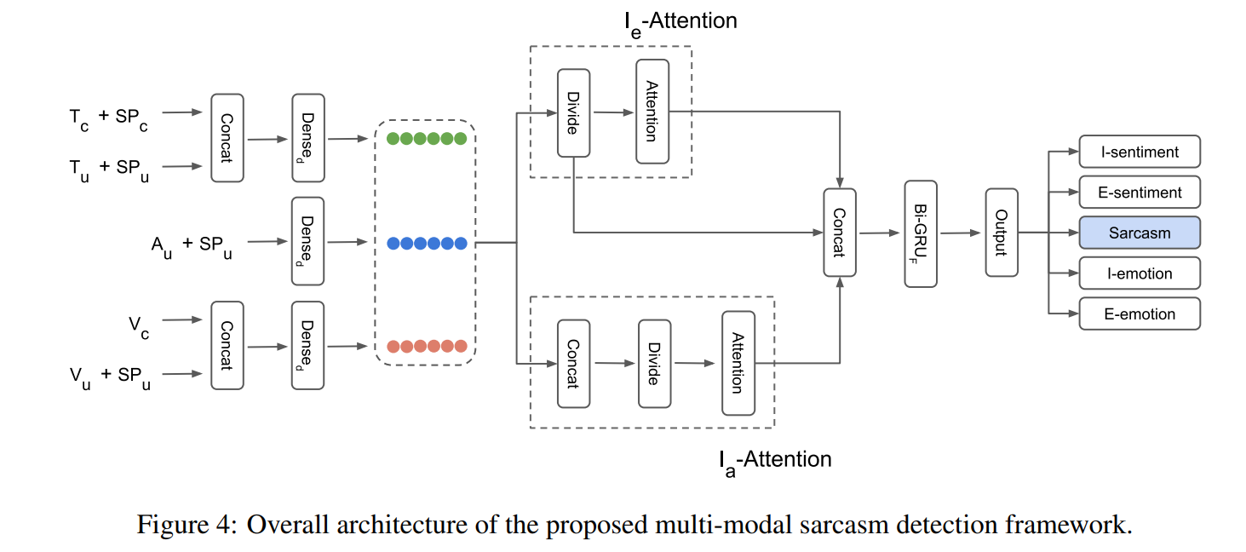
Methodology

Slide 10
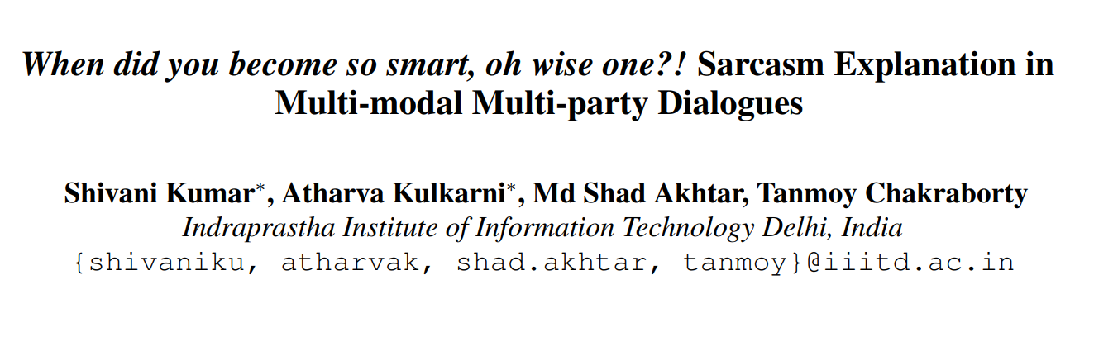
VERY PERI
Introducing the Pantone Color of the Year 2022. PANTONE 17-3938 Very Peri is a dynamic hue that blends the faithfulness and constancy of blue with the energy and excitement of red.
The four color palettes in this template feature Very Peri to help you express your ideas and convey the right mood. Read on to learn how to use these colors in any presentation.

Slide 11
Problem statement
To study the discourse structure of sarcastic conversations and propose a novel task – Sarcasm Explanation in Dialogue (SED) by generating natural language explanations of satirical conversations.
Curate WITS, a new dataset to support our task.

Slide 12
Motivation
research on figurative language has focused predominantly on its identification rather than its comprehension and normalization. This paper addresses this gap by attempting to generate natural language explanations of satirical dialogues.
In summary, much work has been done in sarcasm detection, but little, if any, effort has been placed into explaining the irony behind sarcasm. This paper attempts to fill this gap by proposing a new problem definition and a supporting dataset

Slide 13
Methodology
we extend MASAC (Bedi et al., 2021) – a sarcasm detection dataset for codemixed conversations – by augmenting it with natural language explanations for each sarcastic dialogue. We name the dataset WITS.
To incorporate multimodal information, we propose a unique fusion scheme of Multimodal Context-Aware Attention (MCA2).
Our fusion strategy outperforms the textbased baselines and the traditional multimodal fusion schemes in terms of multiple text-generation metrics.

Slide 14
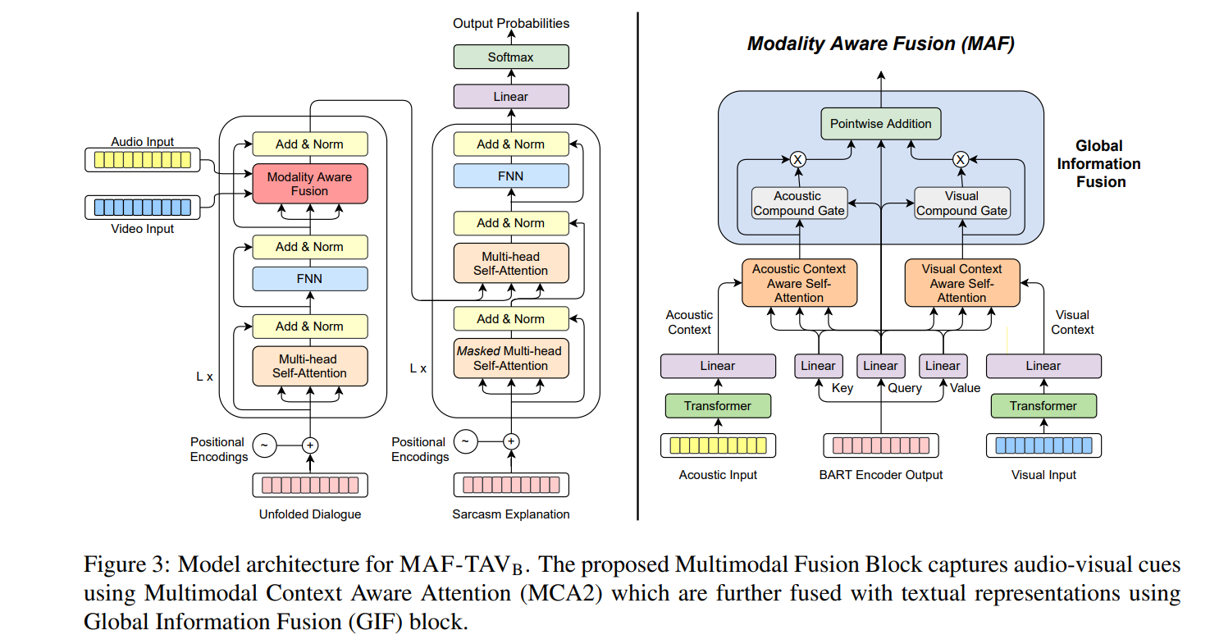
Methodology

Slide 15
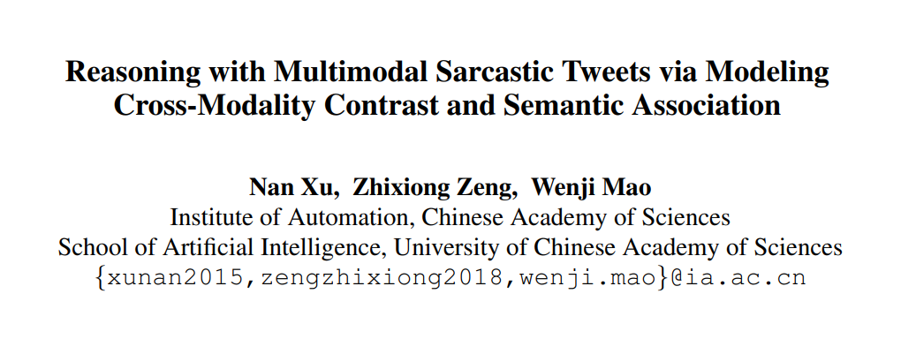
VERY PERI
Introducing the Pantone Color of the Year 2022. PANTONE 17-3938 Very Peri is a dynamic hue that blends the faithfulness and constancy of blue with the energy and excitement of red.
The four color palettes in this template feature Very Peri to help you express your ideas and convey the right mood. Read on to learn how to use these colors in any presentation.

Slide 16
Problem statement
we propose a novel method for modeling cross-modality contrast in the associated context. Our method models both cross-modality contrast and semantic association by constructing the Decomposition and Relation Network (namely D&R Net).
The decomposition network represents the commonality and discrepancy between image and text, and the relation network models the semantic association in cross-modality context.

Slide 17
Motivation
multimodal sarcastic tweets are widely posted on various social platforms.
In multimodal context, sarcasm is no longer a pure linguistic phenomenon, and due to the nature of social media short text, the opposite is more often manifested via cross-modality expressions
Thus traditional text-based methods are insufficient to detect multimodal sarcasm.
Previous methods pay more attention to the fusion of multimodal features, and did not consider cross-modality contrast and semantic association information which is essential to deduce multimodal sarcastic tweets
As the short text in tweet often has insufficient contextual information, contextual contrast implied in multimodal sarcasm is typically conveyed by cross-modality expressions.

Slide 18
Methodology
It is composed of four modules, preprocessing, encoding, decomposition network and relation network.
We first preprocess the image and text inputs and extract adjective-noun pairs (ANPs) from each image. We then encode these triple inputs into hidden representations.
After that, we learn to represent the commonality and discrepancy between image and text in decomposition network as well as the multi-view semantic association information in relation network.
Finally, we feed these cross-modality representations into classification module for multimodal sarcasm detection.

Slide 19
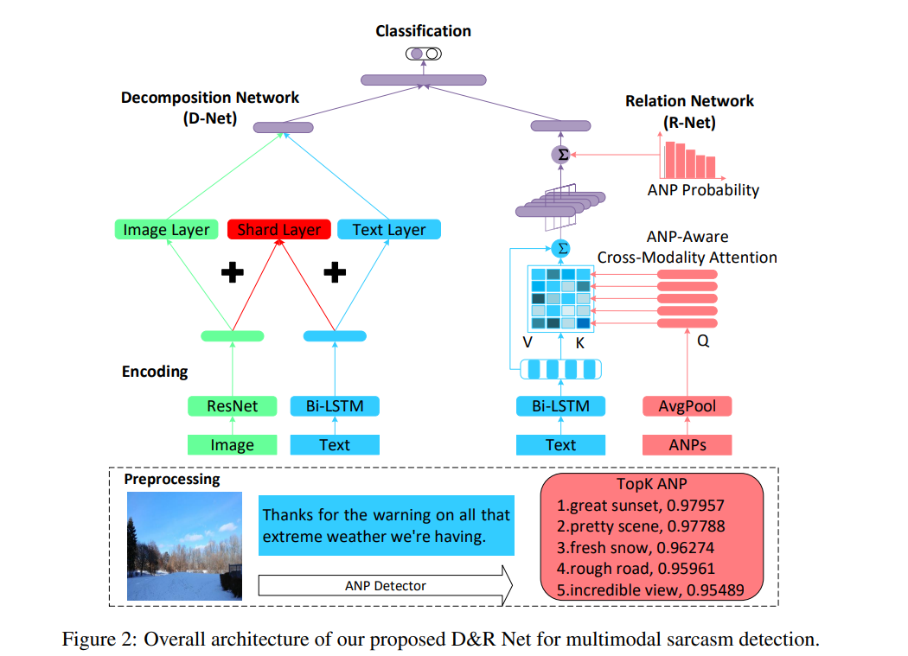
Methodology

Slide 20
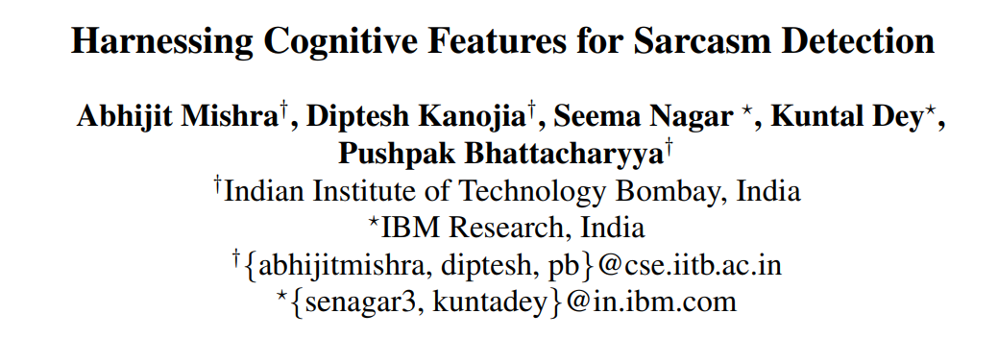
VERY PERI
Introducing the Pantone Color of the Year 2022. PANTONE 17-3938 Very Peri is a dynamic hue that blends the faithfulness and constancy of blue with the energy and excitement of red.
The four color palettes in this template feature Very Peri to help you express your ideas and convey the right mood. Read on to learn how to use these colors in any presentation.

Slide 21
Problem statement
distinctive eye-movement patterns may be observed in the case of successful processing of sarcasm in text in contrast to literal texts.
To propose a novel mechanism for enriching the feature vector, for the task of sarcasm detection, with cognitive features extracted from eye-movement patterns of human readers.
Reading sarcastic texts induces distinctive eye movement patterns, compared to literal texts. The cognitive features, derived from human eye movement patterns observed during reading, include feature type like gaze-fixations and forward and backward saccades.
the cognitive features, along with textual features used in best available sarcasm detectors, are used to train binary classifiers against given sarcasm labels.

Slide 22
Motivation
Sarcasm can often be traced to incongruity that becomes apparent as the full sentence unfolds. This presence of incongruity- implicit or explicit- affects the way readers eyes move through the text.
We observe the difference in the behaviour of the eye, while reading sarcastic and non sarcastic sentences
Motivated by this observation, we augment traditional linguistic and stylistic features for sarcasm detection with the cognitive features obtained from readers eye movement data.
let’s say a book gets different reviews on Amazon. Our system could watch how readers read the review using mobile eye-trackers, and thereby, decide whether the text contains sarcasm or not. Such an application can horizontally scale across the web and will help in improving automatic classification of online review

Slide 23
Methodology
The database consists of 1,000 short texts, each having 10-40 words. Out of these, 350 are sarcastic.
task assigned to annotators was to read sentences one at a time and label them with binary labels indicating the polarity.
SR-Research Eyelink-1000 eye-tracker (monocular remote mode, sampling rate 500Hz) records several eye-movement parameters like fixations (a long stay of gaze) and saccade (quick jumping of gaze between two positions of rest) and pupil size.
We observe this for all participants in our dataset, with the average fixation duration per word for sarcastic texts being at least 1.5 times more than that of non-sarcastic texts.
scanpaths with respect to sarcasm processing have two typical characteristic

Slide 24
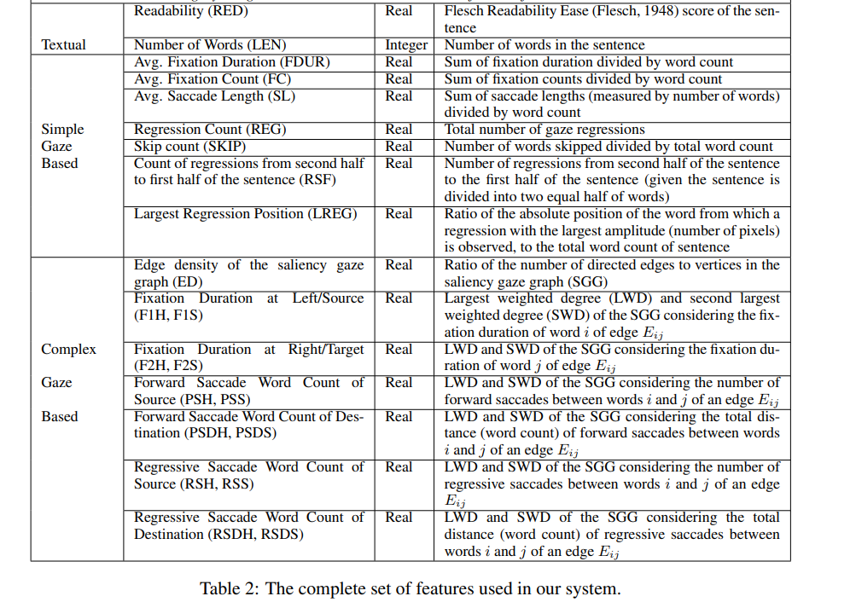
Methodology

Slide 25
Methodology
we observe 16 out of top 20 features to be gaze features. Further, in each of the cases, Average Fixation Duration per Word and Largest Regression Position are seen to be the two most significant features.
Models: Naïve Bayes, SVM, Neural Networks etc.

Slide 26
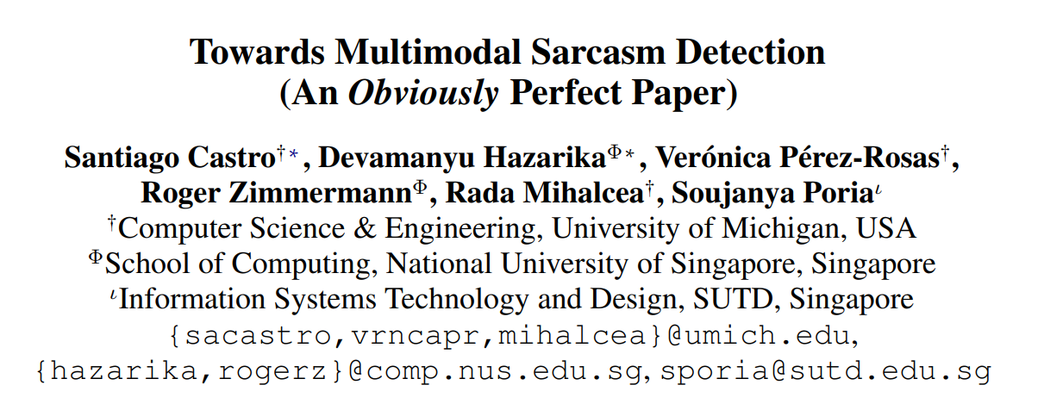
VERY PERI
Introducing the Pantone Color of the Year 2022. PANTONE 17-3938 Very Peri is a dynamic hue that blends the faithfulness and constancy of blue with the energy and excitement of red.
The four color palettes in this template feature Very Peri to help you express your ideas and convey the right mood. Read on to learn how to use these colors in any presentation.

Slide 27
Problem statement
To explores the role of multimodality and conversational context in sarcasm detection and introduces a new resource to further enable research in this area.
We curate a new dataset, MUStARD, for multimodal sarcasm research with high-quality annotations, including both mutlimodal and conversational context features;
We exemplify various scenarios where incongruity in sarcasm is evident across different modalities, thus stressing the role of multimodal approaches to solve this problem;
We also provide preceding turns in the dialogue which act as context information.

Slide 28
Motivation
there are also scenarios where sarcasm lacks explicit linguistic markers, thus requiring additional cues that can reveal the speaker’s intentions.
For instance, sarcasm can be expressed using a combination of verbal and non-verbal cues, such as a change of tone, overemphasis in a word, a drawn-out syllable, or a straight looking face.
Moreover, sarcasm detection involves finding linguistic or contextual incongruity, which in turn requires further information, either from multiple modalities (Schifanella et al., 2016; Mishra et al., 2016a) or from the context history in a dialogue.

Slide 29
Methodology
To enable the exploration of multimodal sarcasm detection, we introduce a new dataset (MUStARD) consisting of short videos manually annotated for their sarcasm property.
Each utterance in our dataset is coupled with its context utterances. Some of the context videos contain multi-party dialogue between speakers participating in the scene.
Each utterance and its context consists of three modalities: video, audio, and transcription (text). Also, all the utterances are accompanied by their speaker identifiers.

Slide 30
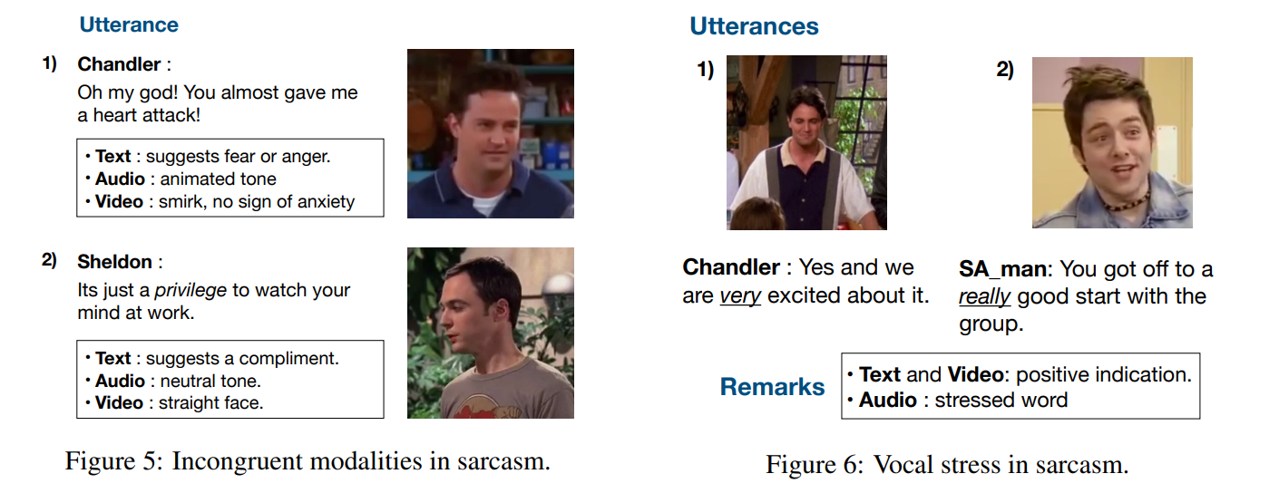
Methodology

Slide 31
Methodology
incongruity between modalities, which acts as a strong indicator of sarcasm.
sarcasm does not necessarily imply conflicting modalities. Rather, the availability of complementary information through multiple modalities improves the capacity of models to learn discriminative patterns responsible for this complex process.
The availability of context in our proposed dataset provides models with the ability to utilize additional information while reasoning about sarcasm.
We obtain several learning features from the three modalities included in our dataset.
Audio: Librosa Library Video: RESNet Text: BERT
Models: SVM

Slide 32
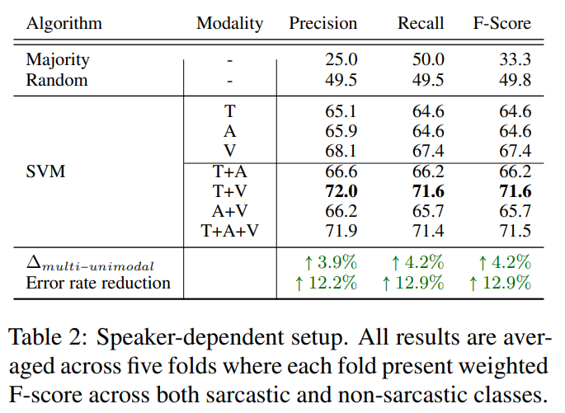
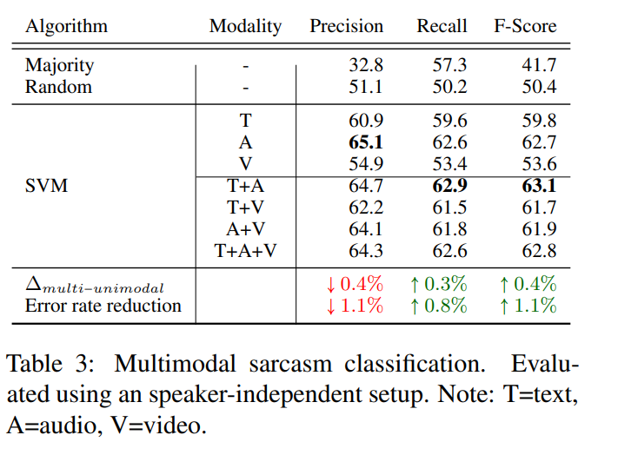
Methodology

Slide 33
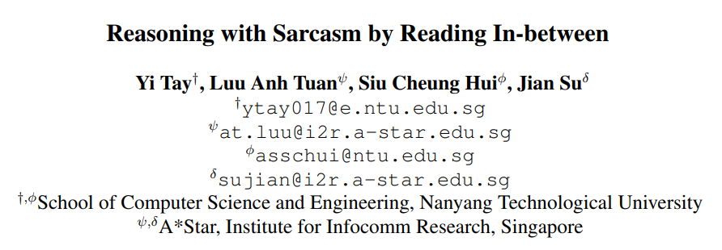
VERY PERI
Introducing the Pantone Color of the Year 2022. PANTONE 17-3938 Very Peri is a dynamic hue that blends the faithfulness and constancy of blue with the energy and excitement of red.
The four color palettes in this template feature Very Peri to help you express your ideas and convey the right mood. Read on to learn how to use these colors in any presentation.

Slide 34
Problem statement
To propose an attention-based neural model that looks in-between instead of across, enabling it to explicitly model contrast and incongruity..
Our proposed model not only achieves state-of-the-art performance on all datasets but also enjoys improved interpretability.

Slide 35
Motivation
To the best of our knowledge, none of the existing state-of-the-art models considered exploiting intra-sentence relationships, solely relying on sequential composition.
State-of-the-art sarcasm detection systems mainly rely on deep and sequential neural networks. This has several shortcomings for the sarcasm detection task. Firstly, there is no explicit interaction between word pairs, which hampers its ability to explicitly model contrast, incongruity or juxtaposition of situations.
Secondly, it is difficult to capture long-range dependencies. In this case, contrastive situations (or sentiments) which are commonplace in sarcastic language may be hard to detect with simple sequential models.
our work is based on the intuition that modeling intra-sentence relationships can not only improve classification performance but also pave the way for more explainable neural sarcasm detection methods

Slide 36
Methodology
Our proposed model, the Multi-dimensional Intra-Attention Recurrent Network (MIARN) is strongly based on the intuition of compositional learning by leveraging intra-sentence relationships.
In the input encoding layer, each one-hot vector is converted into a low-dimensional vector representation (word embedding).
We first begin by modeling the relationship of each word pair in the input sequence. We use Multi-dimensional Intra-Attention
The inputs to the final prediction layer are two representations, namely (1) the intra-attentive representation (va ∈ R n ) and (2) the compositional representation (vc ∈ R d ).

Slide 37
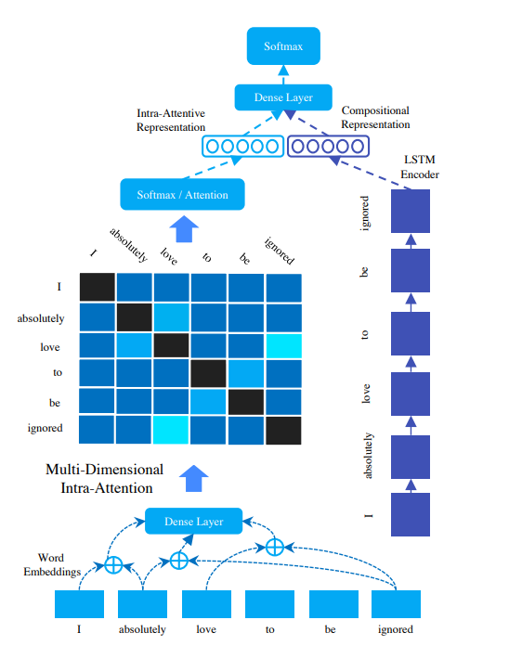
Methodology

Slide 38
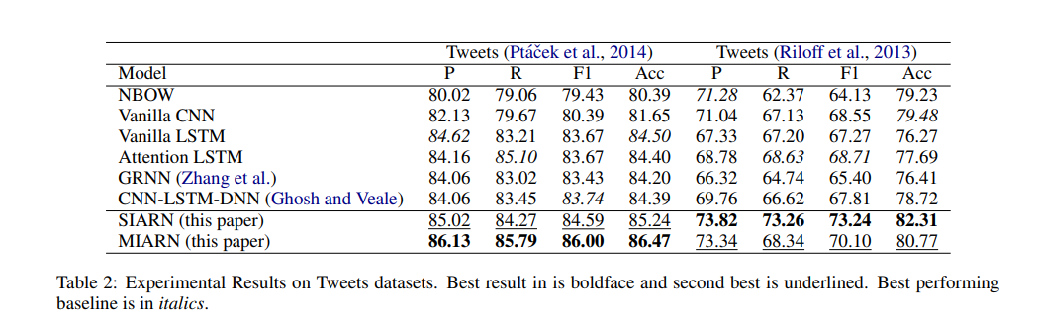
Result

Slide 39
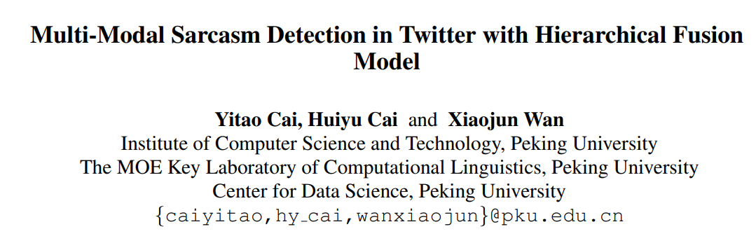
VERY PERI
Introducing the Pantone Color of the Year 2022. PANTONE 17-3938 Very Peri is a dynamic hue that blends the faithfulness and constancy of blue with the energy and excitement of red.
The four color palettes in this template feature Very Peri to help you express your ideas and convey the right mood. Read on to learn how to use these colors in any presentation.

Slide 40
Problem statement
We propose a novel hierarchical fusion model to address the challenging multi-modal sarcasm detection task in Twitter.
We create a new dataset for multi-modal Twitter sarcasm detection and release it1 .
We quantitatively show the significance of each modality in Twitter sarcasm detection.
We further show that to fully unleash the potential of images, we would need to consider image attributes - a high-level abstract information bridging the gap between texts and images.

Slide 41
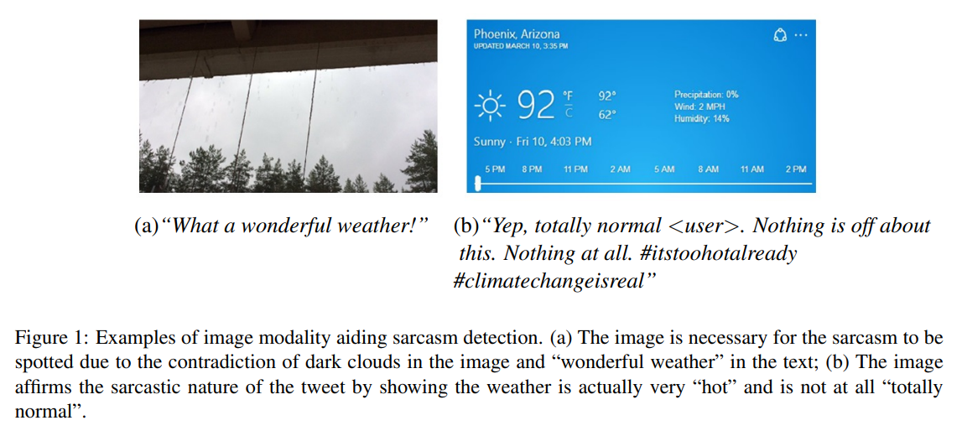
Motivation
To the best of our knowledge, we are the first to deeply fuse the three modalities of image, attribute and text, rather than na¨ıve concatenation, for Twitter sarcasm detection.
detecting sarcasm with only text modality can never be certain of the true intention of the simple tweet.

Slide 42
Methodology
Our model first extracts image features and attribute features, and then leverages attribute features and bidirectional LSTM network to extract text features. Features of three modalities are then reconstructed and fused into one feature vector for prediction.
We create a multi-modal sarcasm detection dataset based on Twitter. Evaluation results on the dataset demonstrate the efficacy of our proposed model and the usefulness of the three modalities.

Slide 43
Methodology
During early fusion, the attribute features are used to initialize a bi-directional LSTM network (Bi-LSTM), which is then used to extract the text features.
The three features then undergo representation fusion, where they are transformed into reconstructed representation vectors.
A modality fusion layer performs weighted average to the vectors and pumps them to a classification layer to yield the final result.
Our results show that all three types of features contribute to the model performance.
Furthermore, our fusion strategy successfully refines the representation of each modality and is significantly more effective than simply concatenating the three types of features.

Slide 44
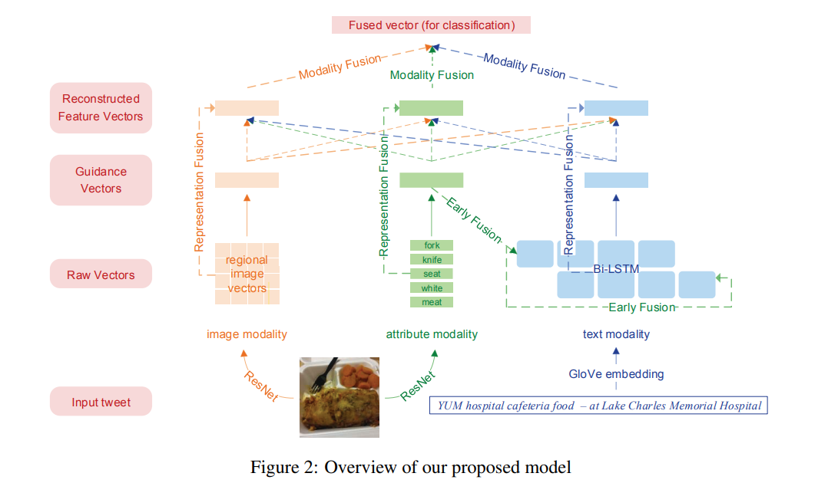
Methodology

Slide 45
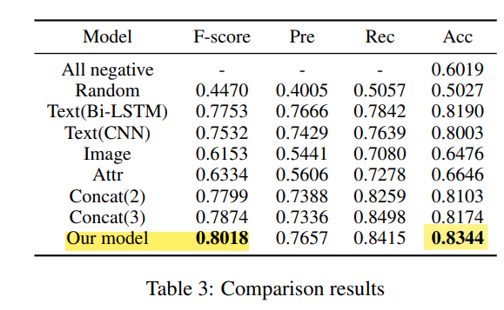
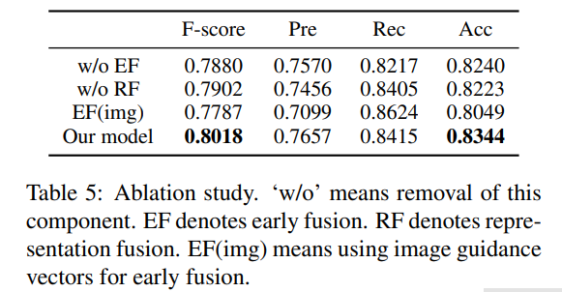
Result

Slide 46
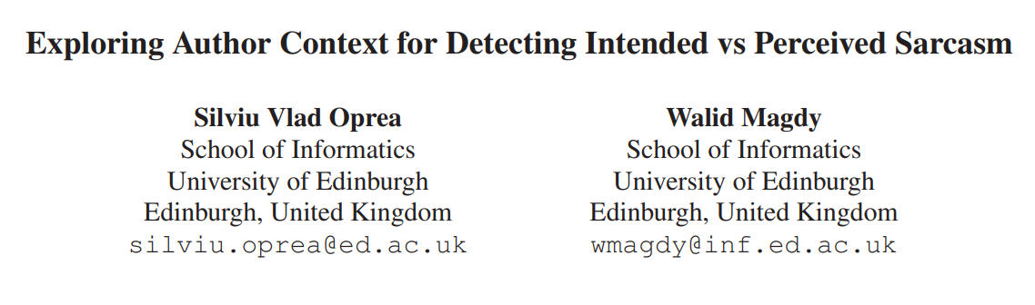
VERY PERI
Introducing the Pantone Color of the Year 2022. PANTONE 17-3938 Very Peri is a dynamic hue that blends the faithfulness and constancy of blue with the energy and excitement of red.
The four color palettes in this template feature Very Peri to help you express your ideas and convey the right mood. Read on to learn how to use these colors in any presentation.

Slide 47
Problem statement
To investigate the impact of using author context on textual sarcasm detection based on Twitter data. Also study the impact of context on Intended vs Perceived Sarcasm.
We experiment with two tweet datasets, one labelled manually for sarcasm [Perceived Sarcasm], and the other via tag-based distant supervision[Intended Sarcasm].

Slide 48
Motivation
sarcasm is a contextual phenomenon and detecting it often requires prior information about the author, audience and previous interactions between them, that originates beyond the text itself.
previous research that considers author context only experiments on tag based distant supervision datasets.
We experiment on datasets representative of both labelling methods, namely Riloff (Riloff et al., 2013), labelled manually, and Ptacek (Pta´cek, Habernal, and Hong ˇ , 2014), labelled via distant supervision

Slide 49
Methodology
our findings indicate a difference between the sarcasm that is intended by the author, captured by distant supervision, represented in Ptacek, and sarcasm that is perceived by the audience, captured by manual labelling represented in Riloff. Reasoning to socio-cultural differences between the author and the audience.
For a user with tweet t in Riloff, we collected those historical tweets posted before t.
We suggested several neural models to build user embeddings, achieving state-of-the-art results for distant supervision, but not for manual labelling.

Slide 50
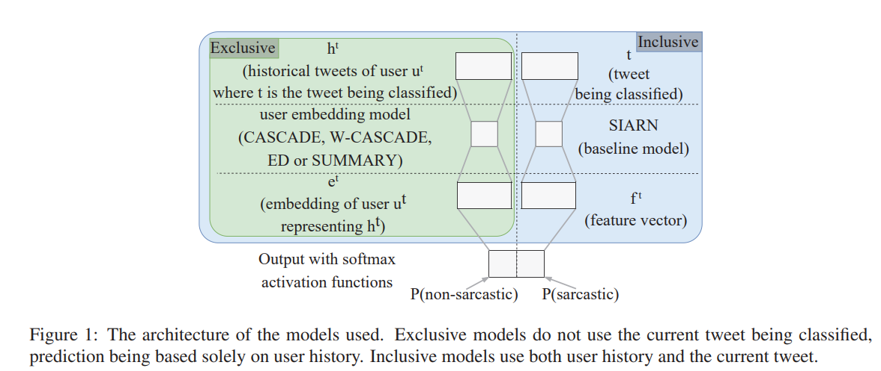
Methodology

Slide 51
Methodology
User embeddings show remarkable predictive power on the Ptacek dataset. Ex-CASCADE model, we get better results (f1-score 0.922) than the baseline (f1-score 0.863) without even looking at the tweet being predicted. On the Riloff dataset, however, user embeddings seem to be far less informative.
Author history seems therefore predictive of authorial sarcastic intention, but not of external perception.

Slide 52
THANK YOU

